Slide 1
SUBJECT: ENGLISH LANGUAGE 1° GRADE LICEO AGRÍCOLA CHILLÁN

Slide 2
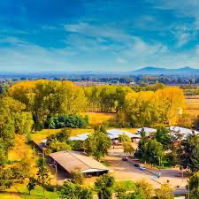
REMEMBER!
HELLO!!!
OBJECTIVE (S)
GROUP WORK
SCHEDULE

Slide 3
DATE:
OBJECTIVE: The importance of the english language, group conversation and use expressions of Greetings and farewells.

Slide 5
DID YOU MAKE UP YOUR MIND ?
https://www.youtube.com/watch?v=Q1JdcvMv8yA

Slide 6
HI 1°-YEAR STUDENTS
GREETINGS: HELLO, HI!, GOOD MORNING…
EVERYDAY QUESTIONS: WHAT IS YOUR NAME? ; WHERE ARE YOU FROM?; WHAT DO YOU DO? …
FAREWELLS: BYE-BYE; SEE YOU, TAKE CARE!

Slide 7
https://www.youtube.com/watch?v=WR9_nsLyaEY

Slide 9
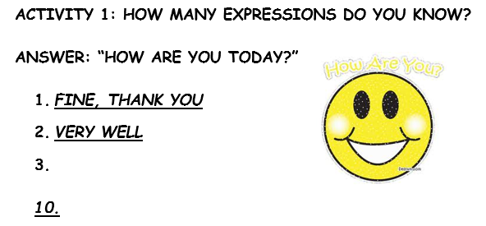

Slide 13
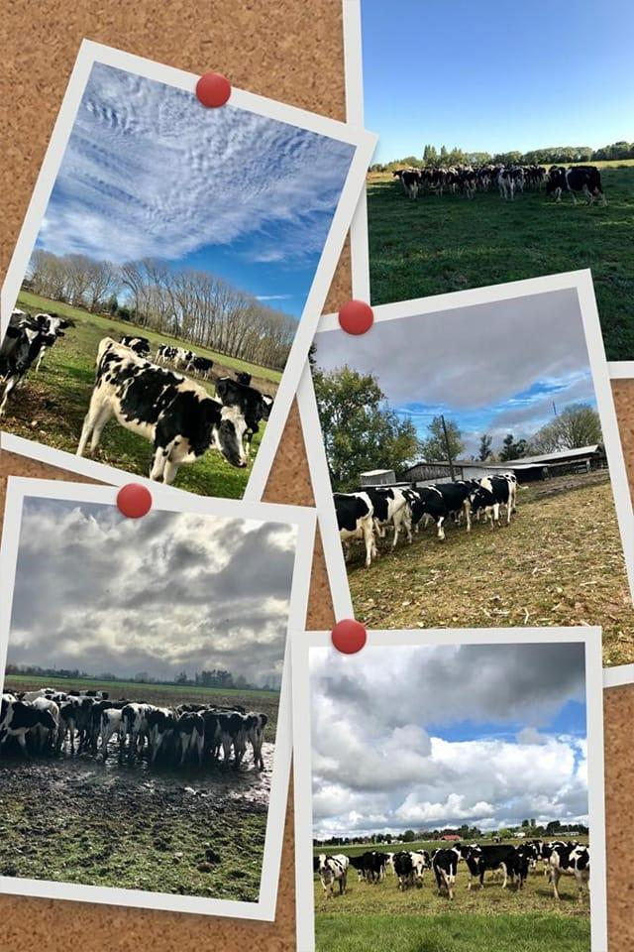
1° GRADE TASK TIME!
GROUP WORK 3-4 STUDENTS
MAKE A DIALOGUE IN ENGLISH OF A SCHOOL SITUATION AT ONE SECTION OF LICEO AGRÍCOLA CHILLÁN. (AGRICULTURE LIVESTOCK TECHNICIAN OR AUTOMOTIVE MECHANICS TECHNICIAN)
BE CREATIVE
USE VOCABULARY AND EXPRESSIONS
USE YOUR REAL NAMES
ROLE PLAY YOUR DIALOGUE
EACH PARTICIPANT INTERACTS AT LEAST 6 TIMES

Slide 15
MANUE
MANUEL MOLINA O.
PROFESOR DE INGLÉS LICEO AGRÍCOLA CHILLÁN
SNA EDUCA
CHILLAN.P.MMOLINA@SNAEDUCA.CL

