Slide 1
SPELLING BEE
PRACTICE 2023

Slide 2
LICENSE PLATES OF THE WORLD

Slide 3
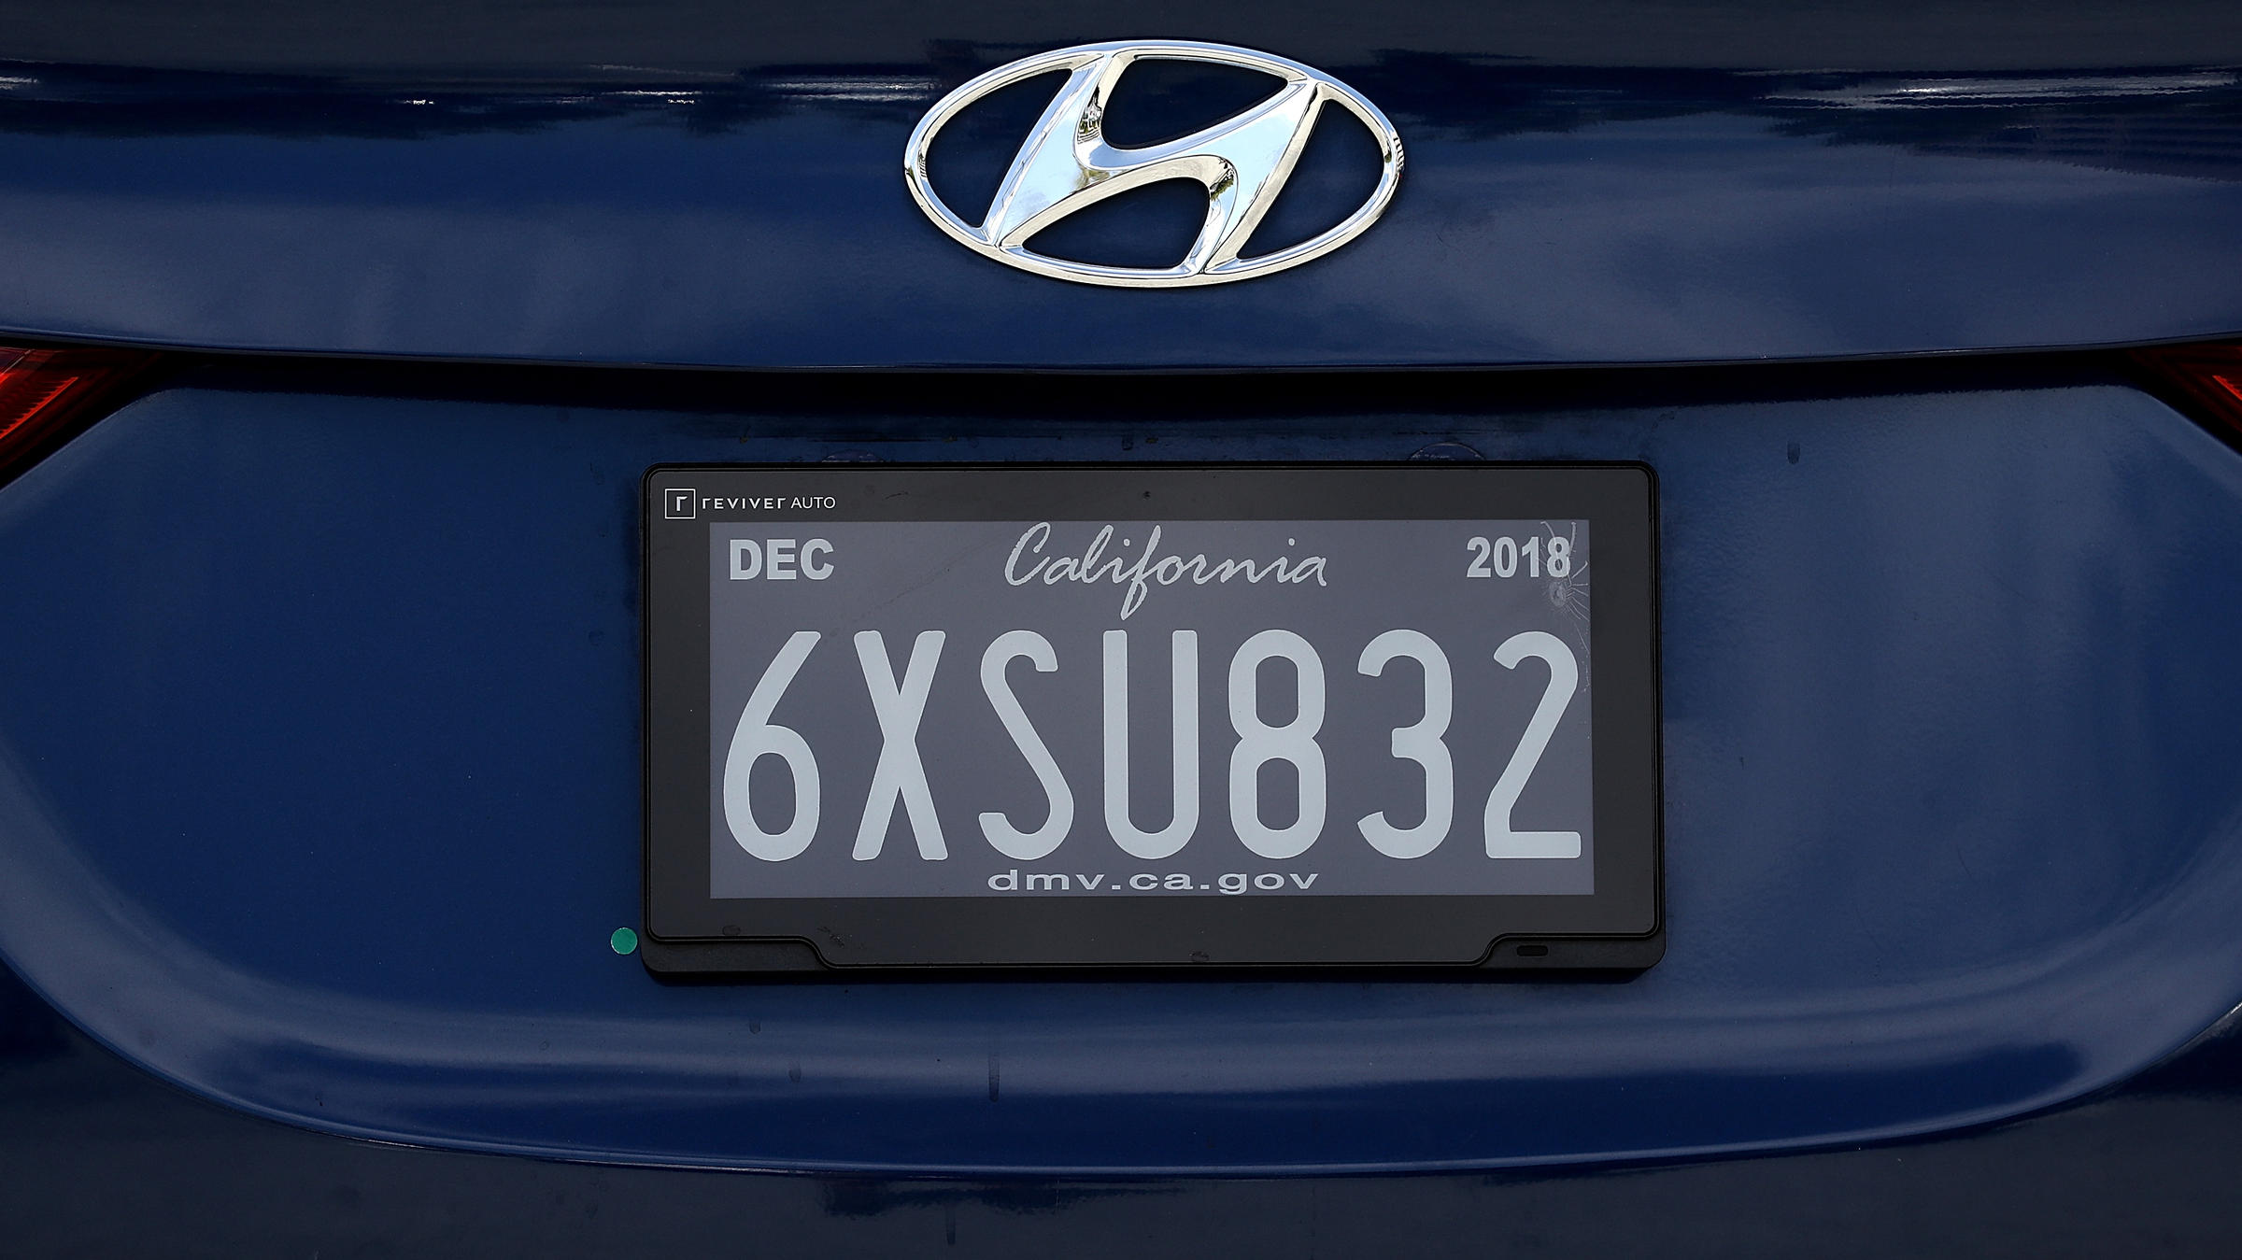
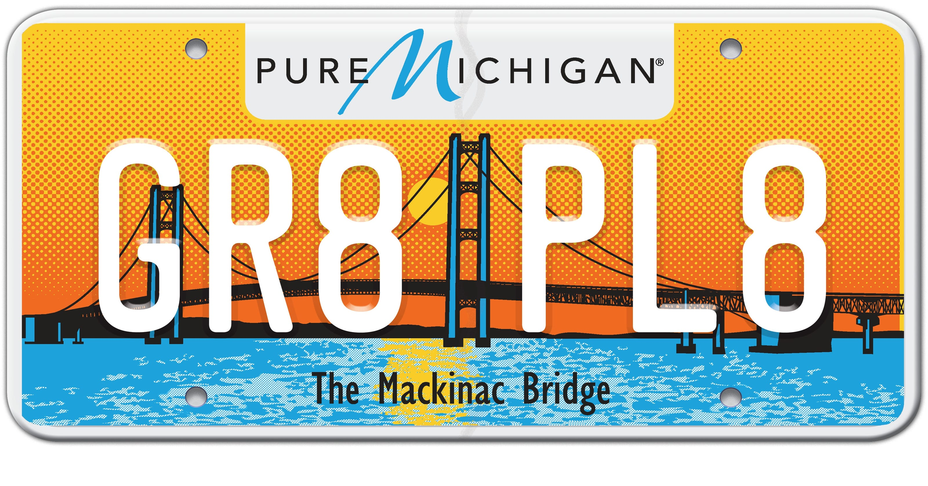
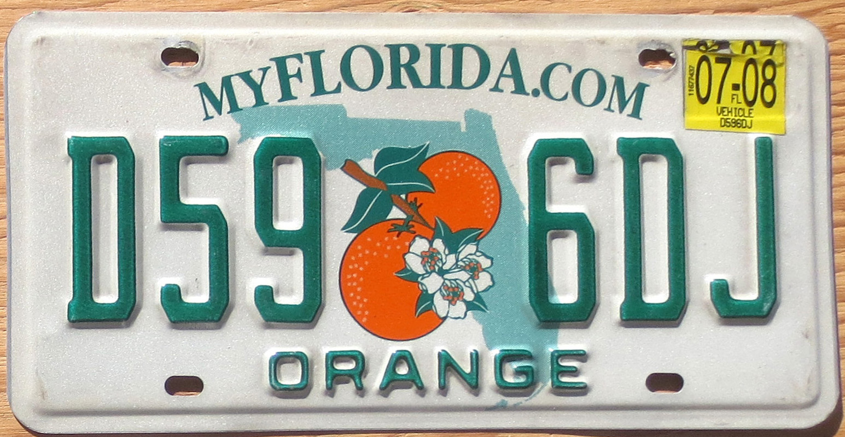
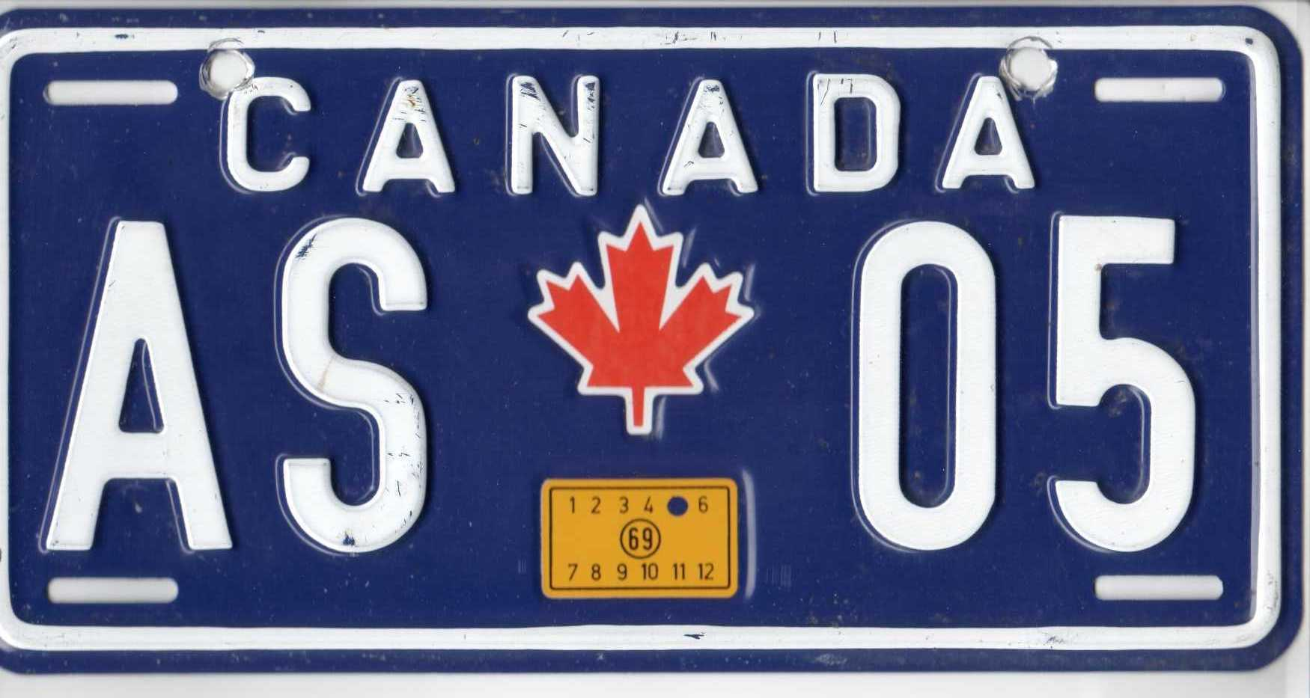
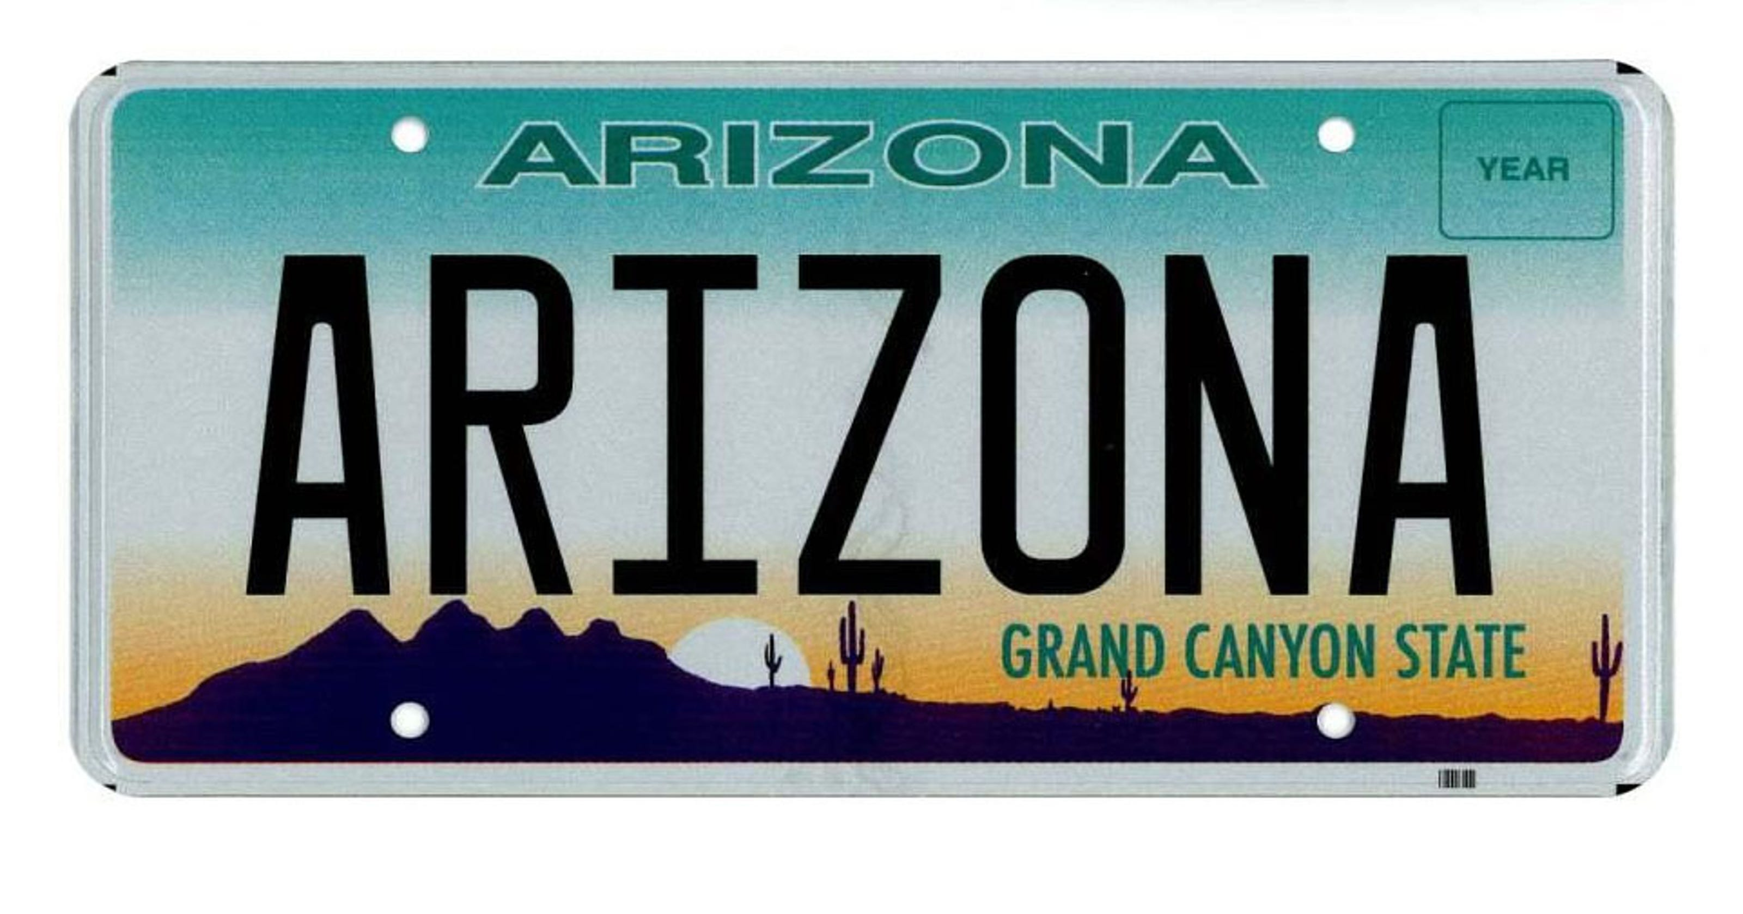
LICENSE PLATES OF THE WORLD
LET’S SPELL IN ENGLISH

Slide 4
THE MORE YOU PRACTICE… THE MORE YOU LEARN!
SAY THE WORD
SPELL IT OUT
REPEAT THE WORD

Slide 5
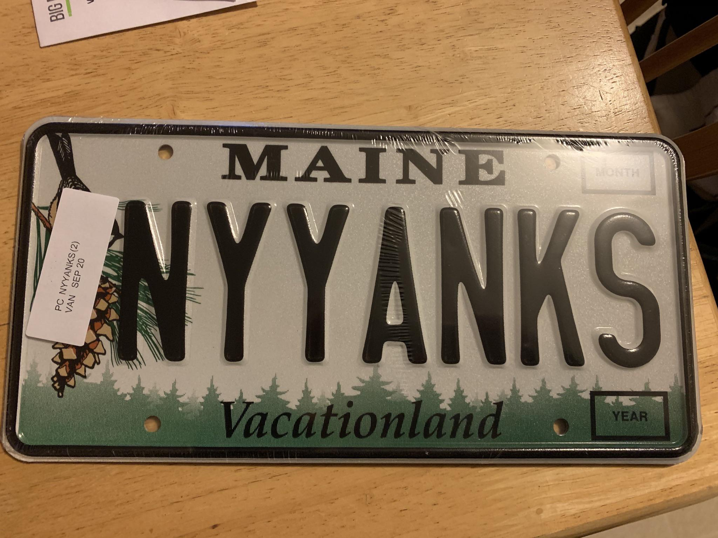
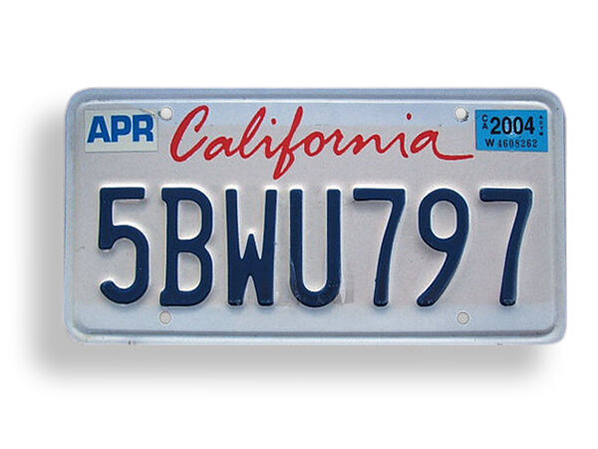
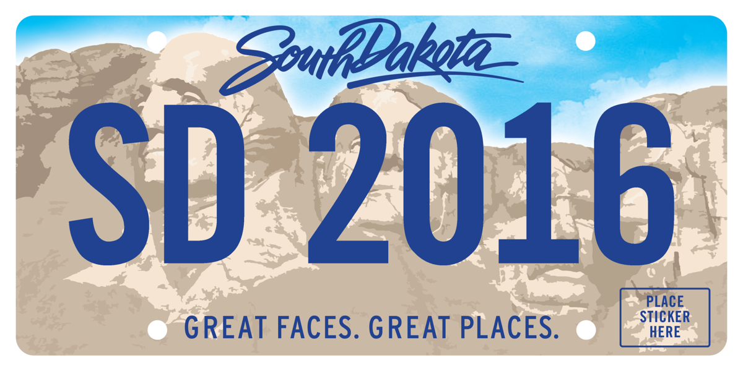
YOU CAN DO IT!

Slide 6
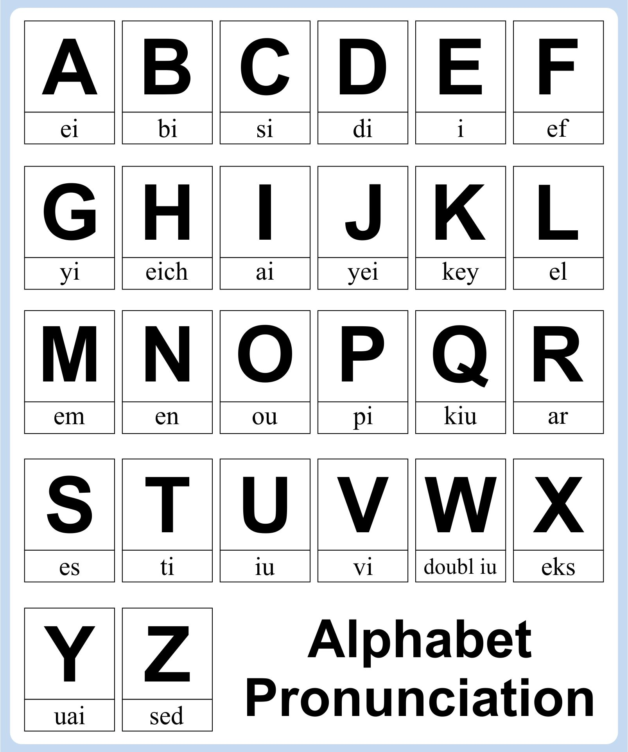
LEARNING IS FUNTASTIC!!!

